Slide 1
XFLR5 Methods and Their Application in “Constraints on the Wing Morphology of Pterosaurs”
By: Colin Parker

Slide 2
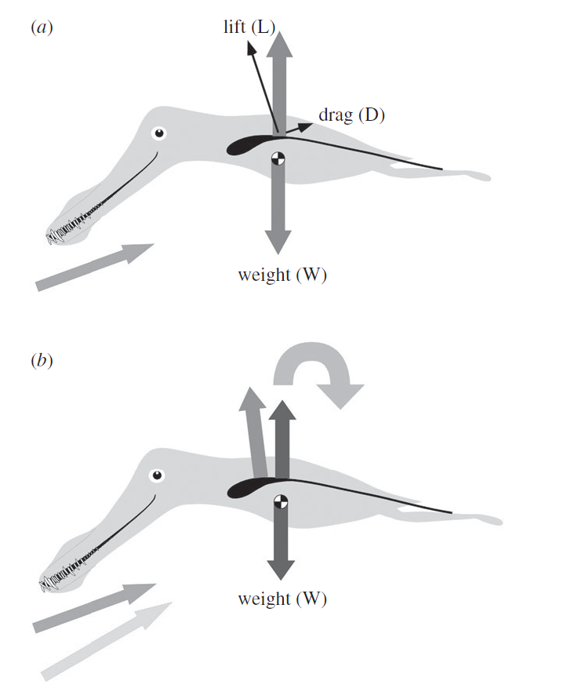
Longitudinal Stability Analysis

Slide 3
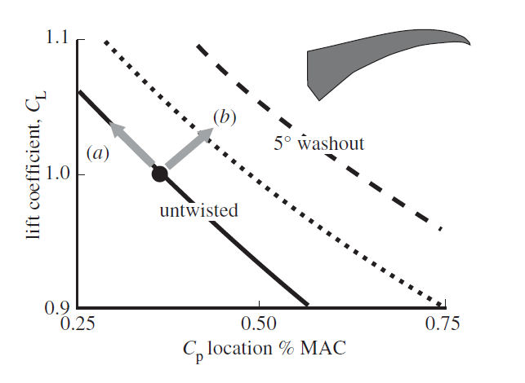
Effects of Washout

Slide 4
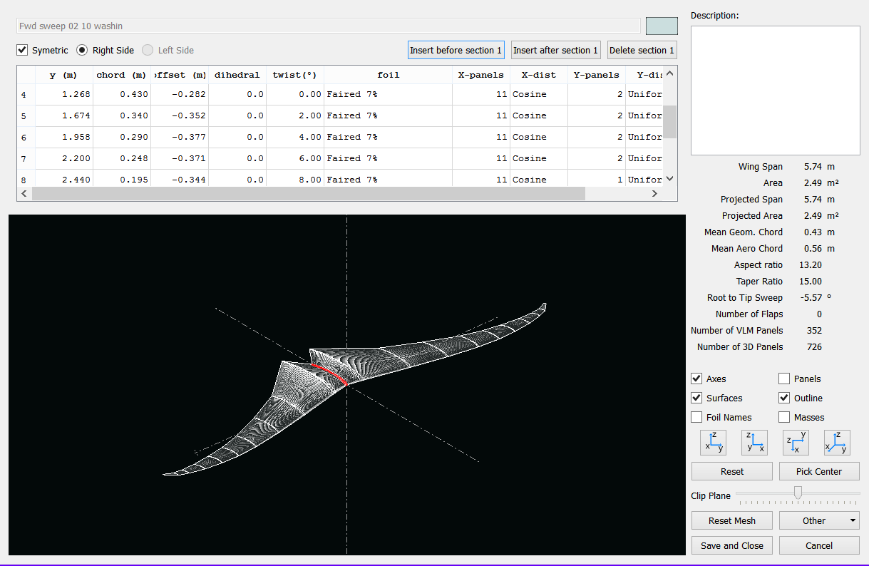
XFLR5

Slide 5
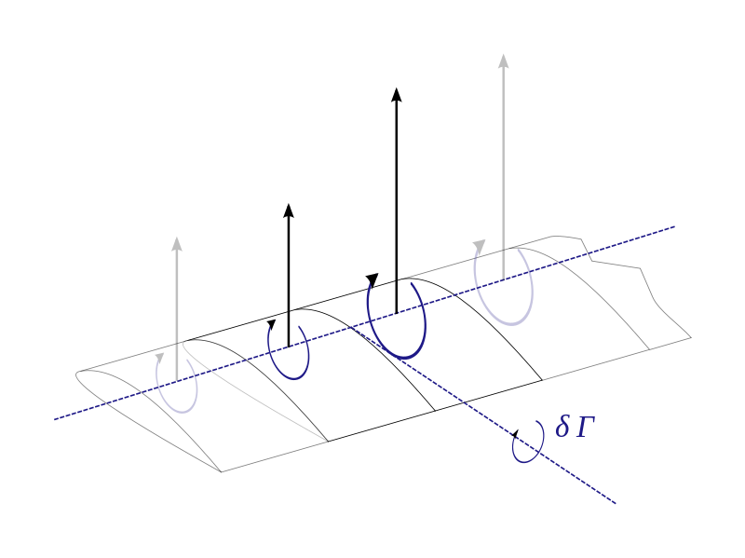
LLT Lifting Line Theory

Slide 6
VLM Vortex Lattice Method

Slide 7
VLM 1

Slide 9
VLM2

Slide 11
3D Panel Method

Slide 12
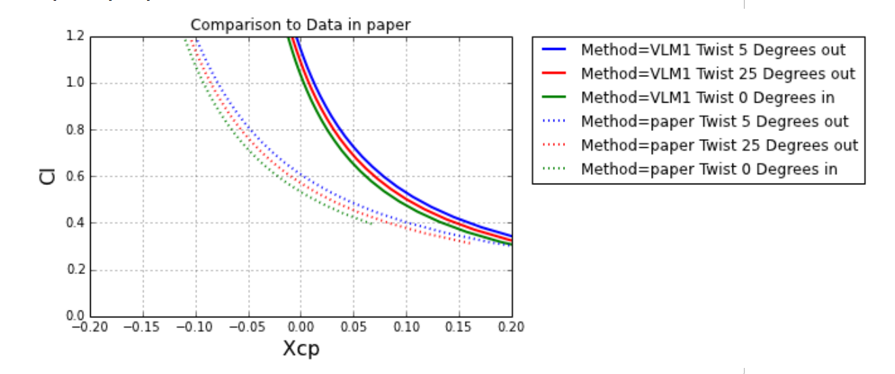

Slide 13
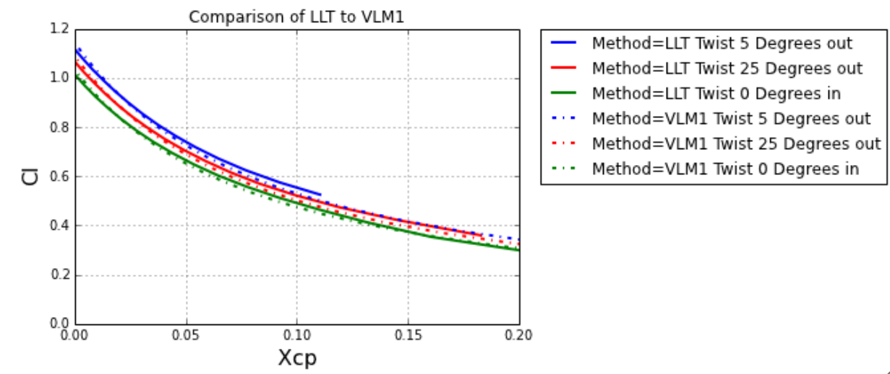

Slide 14
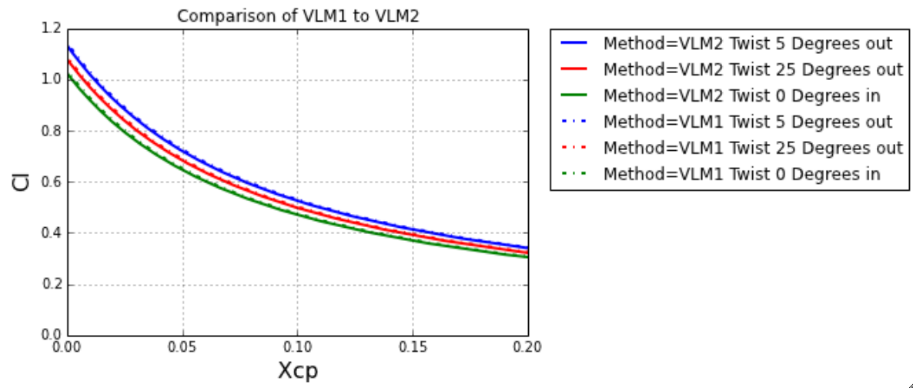

Slide 15
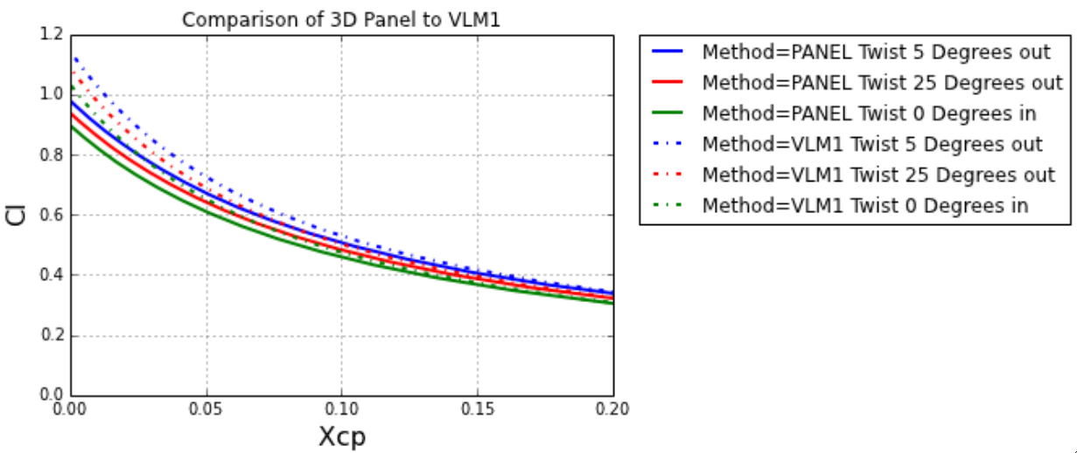

Slide 16
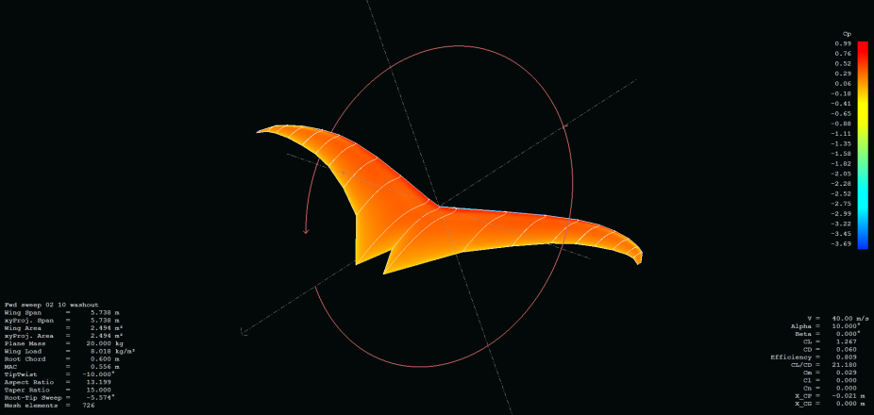
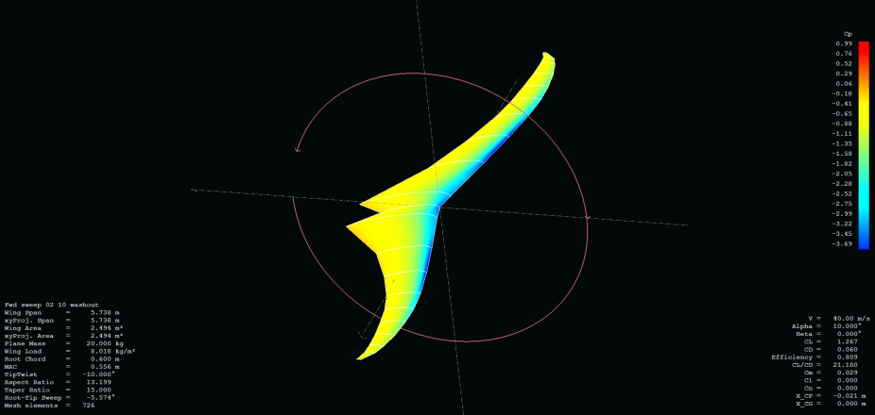
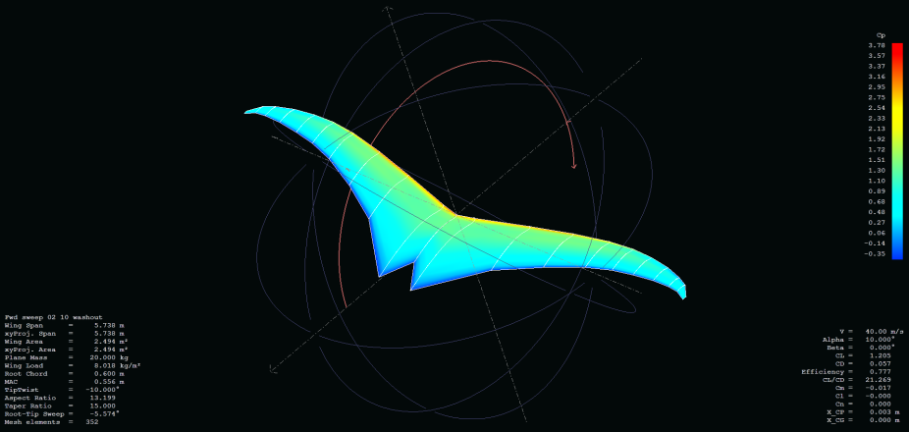
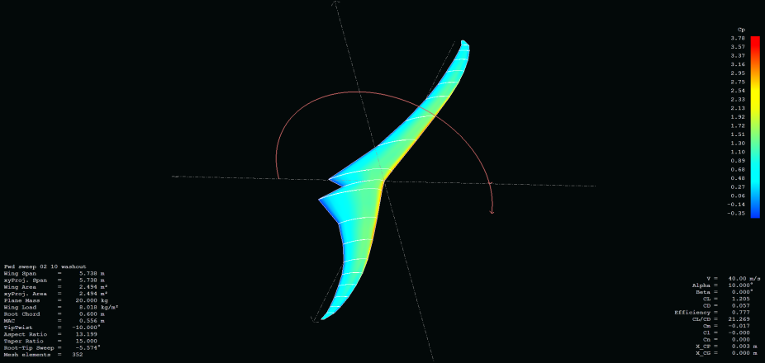
3D Panel
VLM1

Slide 20
Question?

